Slide 1
Secure Group Key Distribution in Constrained Environments with IKEv2
Nils gentschen Felde, Tobias Guggemos, Tobias Heider and Dieter Kranzlmüller
MNM-Team
Ludwig-Maximilians-Universität München
2017 IEEE Conference on Dependable and Secure Computing
Taipei • Taiwan

Slide 2




Typical IoT
Management Architecture
ID
Management
Access
Management
Key
Management
?????

Slide 3

Question
Group key distribution also enables universal key distribution
In this work, we focus
on the problem of
Key Management
in the special case of
group communication
includes most major IoT-related communication models
Securing groups can help securing IoT in general

Slide 4

Challenge of interoperability
Re-using existing
solution and make them
suitable for constrained
environments

Slide 5
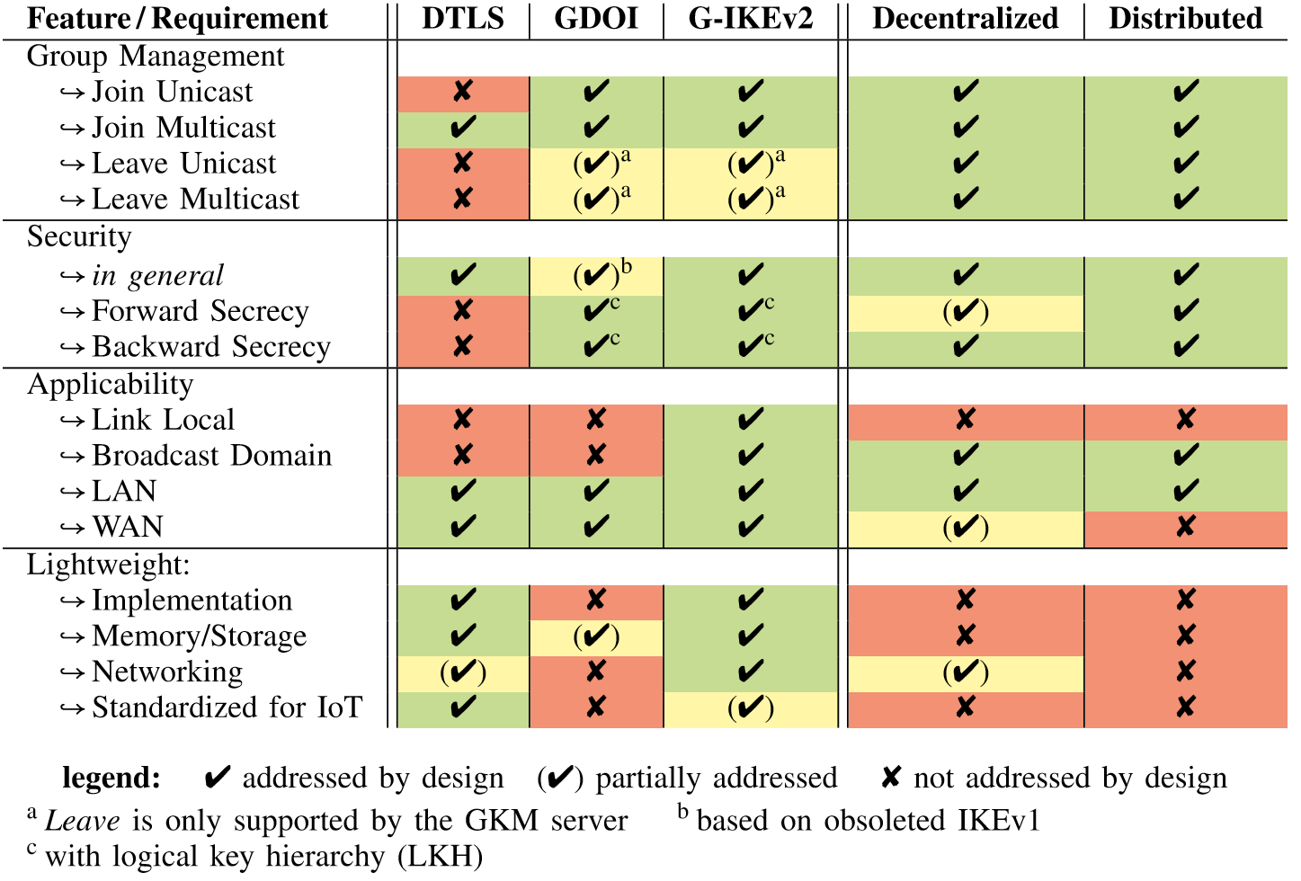
Re-use existing solutions
Requires specifications
for Group Managment
Widely used and
standardized for
constrained networks

Slide 6
Re-use existing solutions
7 messages for
key distribution
→ Too heavy for
constrained environments
Especially designed for
group managment

Slide 7
Re-use existing solutions
- Does not scale for
large groups
- Not useful for WANs
No central authority

Slide 8
Re-use existing solutions
Problem with trust in
dynamic environments
Reduces Network
and computing
overhead

Slide 9
Re-use existing solutions
Not widely supported
- Designed for GKM
- Based on IKEv2, which
is optimized for IoT

Slide 10

Evaluation
How does G-IKEv2
perform on
constrained environments

Slide 11



Testbed
Devices | Arduino Uno | Arduino M0+ | Arduino Due
Architecture | ATmega328 | ARM Cortex-M0+ | ARM Cortex-M3
CPU | 16 MHz | 48 MHz | 84 MHz
RAM | 2 KB | 32 KB | 96 KB
Flash | 32 KB | 256 KB | 512 KB
Operating System | RIOT OS | RIOT OS | RIOT OS

Slide 12
The G-IKEv2 Protocol

Slide 13
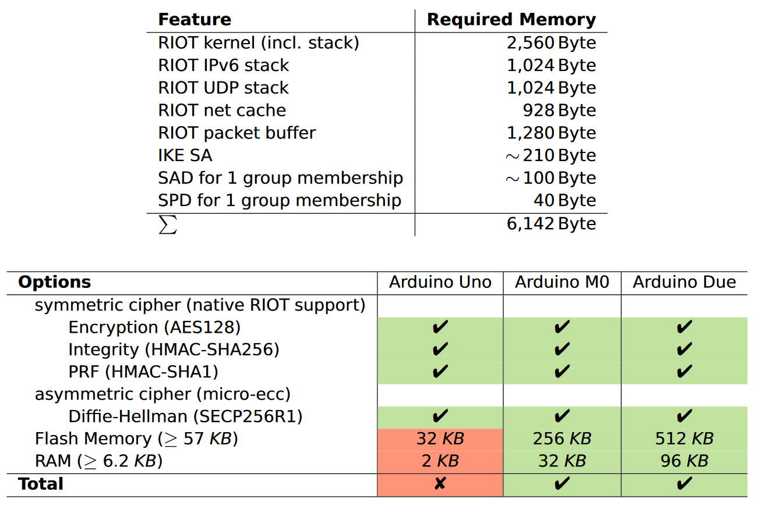
Implementation

Slide 14
Evaluation
Asymmetric EC Diffie Hellman
Only ones for initial
connection with key server

Slide 15
Conclusion
Group Management will become more important for IoT
GKM is widely studied, but underrepresented for constrained scenarios
IKEv2 is already used for Key Distribution in Wireless Networks (e.g. 802.15.4)
➔ G-IKEv2 is an interesting option for group key management in IoT scenarios

Slide 16

The End
Curious?
MNM-Team
Ludwig-Maximilians-Universität München
http://www.mnm-team.org/projects/embedded

