Slide 1
Welcome to the Leibniz Supercomputing Centre of the Bavarian Academy of Sciences and Humanities

Slide 2
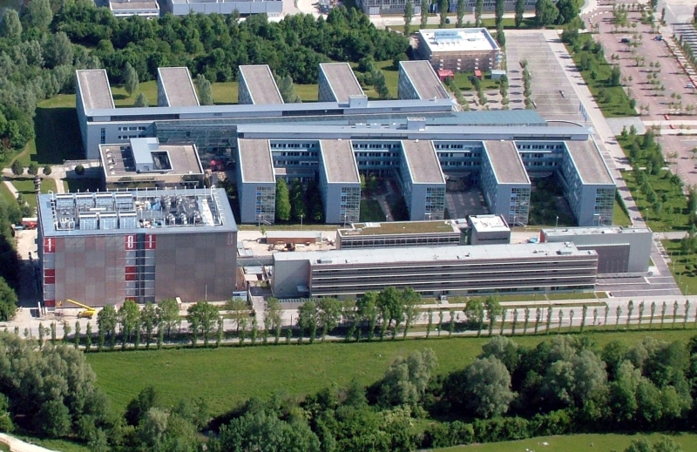
Leibniz-Rechenzentrum

Slide 3
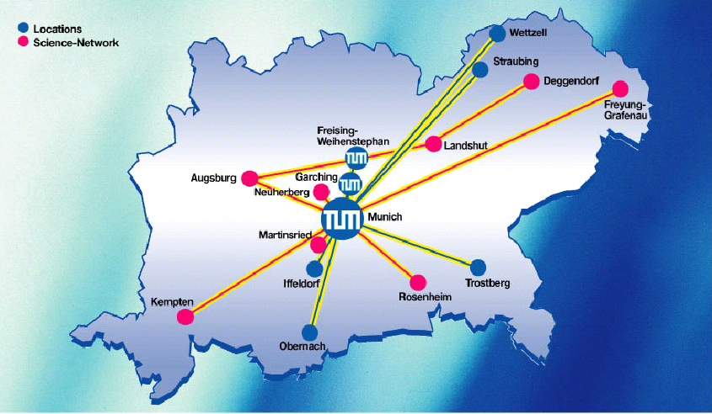
Munich Region: High-Tech Cluster…
Aerospace
Airbus
ESG
Galileo Industry
Astrium
IABG
Airbus Helicopters
…
Information and
Communication
Siemens
Infineon
Sun
Intel
HP
General Electric
…
Automotive
BMW
Audi
MAN
…
Finance
Allianz
Bay. Landesbank
HypoVereinsbank
MünchnerRück
…
Software
SoftLab
Nemetschek
Oracle
Microsoft
sd&m
Research
DLR
FhG
Max-Planck
LMU
HM
TUM
Univ. der Bundeswehr
…
Venture Capitalists
3i
Apax
Atlas Venture
EarlyBird
TVM
Wellington Partners
…
Life Sciences,
Media, Telecommunication,
Environmental Engineering…
Patent
European Patent Office
German Patent Office

Slide 4
LRZ: Organisational Embedding
Bavarian State Ministry of
Education, Science and the Arts
Ludwig-Maximilians-
Universität München
Bavarian Academy of
Sciences and
Humanities
Technische
Universität
München
Other Bavarian Universities
LRZ Advisory Board
Board of Directors of the Leibniz-Supercomputing Centre
Prof. Kranzlmüller (Chairman),
Prof. Bode, Prof. Bungartz, Prof. Hegering
Leibniz Supercomputing Centre

Slide 5
The Leibniz Supercomputing Centre
Computer Centre for all Munich Universities
160 employees and 43 extra staff
More than 100,000 students
30,000 professors, scientific and other staff
IT Services for the universities in Munich and other big customers like BSB, BVB (Bavarian Libraries), Hochschulstart
Mail, Web, Hosting, Cloud and Storage Cloud Services, licences, special equipment
Backup and Archiving Centre (48 petabyte, more than 21 billion files)

Slide 6
The Leibniz Supercomputing Centre
IT Competence centre (Networks, HPC, Grid Computing, IT Management)
IT Research
High Performance Computing Centre for Bavaria‘s Universities
National Supercomputing Centre
Gauss Centre for Supercomputing
Integrated in European HPC and Grid projects

Slide 7
Munich Scientific Network (MWN)
Operation figures
16 Routers
1,500 Switches
2,900 Access points
76 leased dark fibres
40+ private dark fibres
> 150,000 systems connected
50 Locations with more than 540 groups of buildings
Connecting Munich‘s universities to the internet with 10 Gbit/s
1,200/800 Terabyte per month incoming/outgoing
22 Petabyte per month via backbone

Slide 8
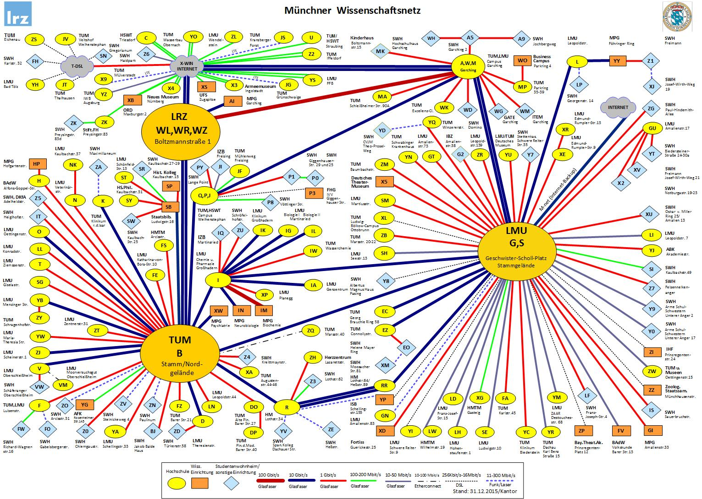
Munich Scientific Network (MWN)

Slide 9
LRZ‘s User Services and Systems
IT service provider for all Munich Universities
> 1,200 web servers, including www.tum.de and the eLearning systems „Moodle“ for LMU and TUM
E-mail services including anti-spam measures
Groupware based on Microsoft Exchange
Special equipment
Virtual Reality and Visulisation Centre
Video conferencing
Scanners for slides and large documents, large scale plotters

Slide 10
LRZ‘s User Services and Systems
IT competence centre for all Munich Universities
Service Desk, support and individual consulting
Consulting (security, network concepts, scientific computing…)
Courses (text editing, image processing, UNIX, Linux…)

Slide 11
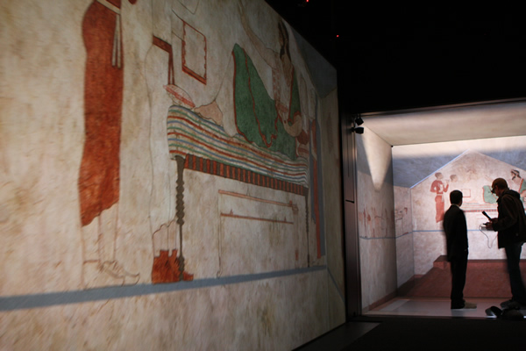
Virtual Reality and Visualisation Centre
Powerwall (4k resolution at 6 x 3,15 m
5-sided projection installation (2,70 m x 2,70 m)
Both equipped with optical tracking
Reconstruction of the tomb of Karaburun

Slide 12
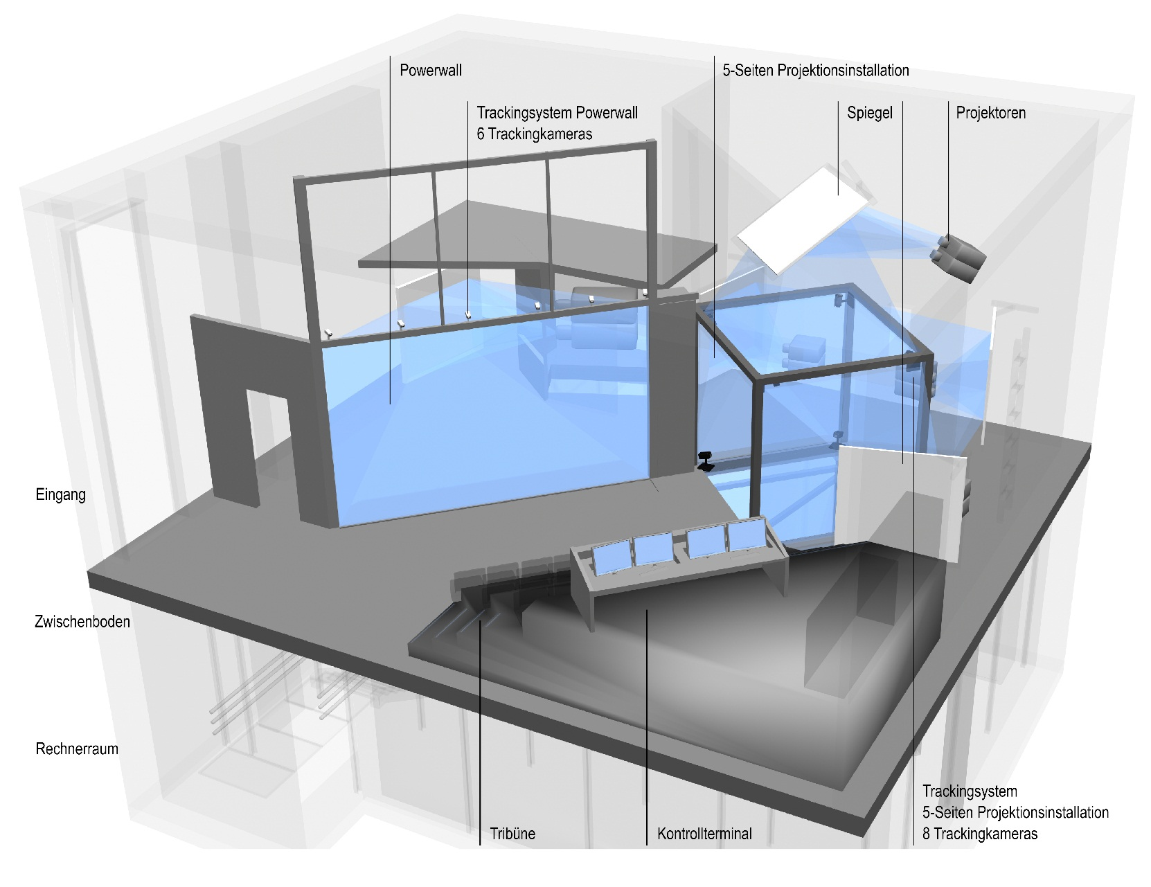
Virtual Reality and Visualisation Centre

Slide 13
Backup and Archiving Systems at LRZ
Occupancy
48 Petabyte data
21 billions files
117 Terabyte data incoming per day
9,654 registered systems
Configuration
5 tape libraries
154 tape drives
46,000 tape cartridges
approx. 3 Petabyte disk cache

Slide 14
The LRZ: a Supercomputing Centre
SuperMUC (Phase 1)
3 PF, > 300 TB Memory, > 156,000 cores
SuperMUC (Phase 2)
3 PF, 200 TB Memory > 86,000 cores
Linux Cluster
Heteorogenous, Several flavours
Continuously expanded
327 TF, 33 TB, 16.180 cores
Housing for LCG and others
SuperMUC 6 PF
Large Shared Memory SGI Ultra Violet General Purpose Parallel: SGI Ice
Massively Parallel Processing
Massively Serial Processing
Linux Hosting and Housing / Grid / LHC

Slide 15
Research at LRZ
IT Management
Piloting new Network Technologies
Long-term Archiving
Grids
Computational Science, Computer Architecture
Computer Architecture for Servers and Supercomputers
Energy Efficient Servers and Datacenters

Slide 16
Research at LRZ
IT Management (Methods, Architectures, Tools)
Research Topics
Service Management (Impact Analysis, CSM, SLA Mgmt, Monitoring)
ITIL (Process Refinements, Mapping to tools, Benchmarking)
Cross-Domain Management
Security Management in Federations
Virtualization
Projects
WebCNM, GN3plus, SASER

Slide 17
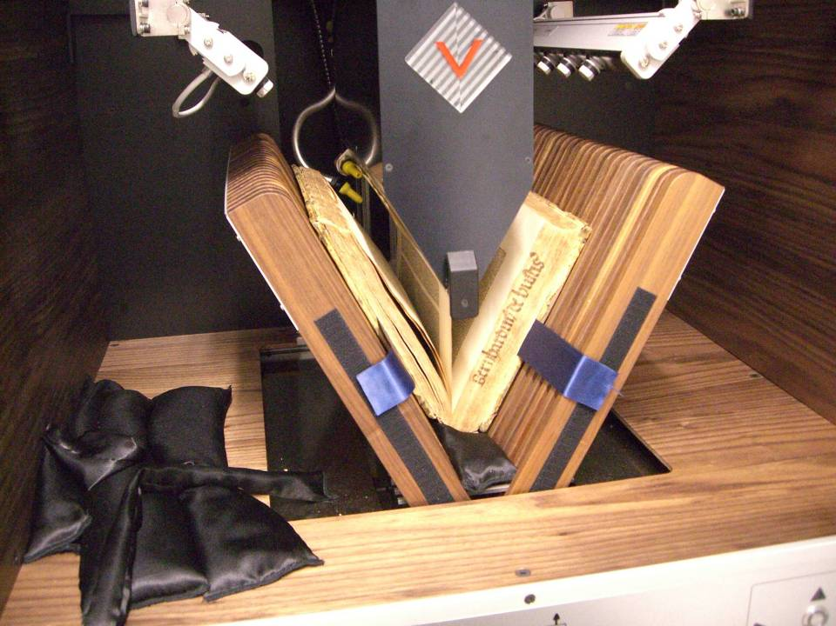
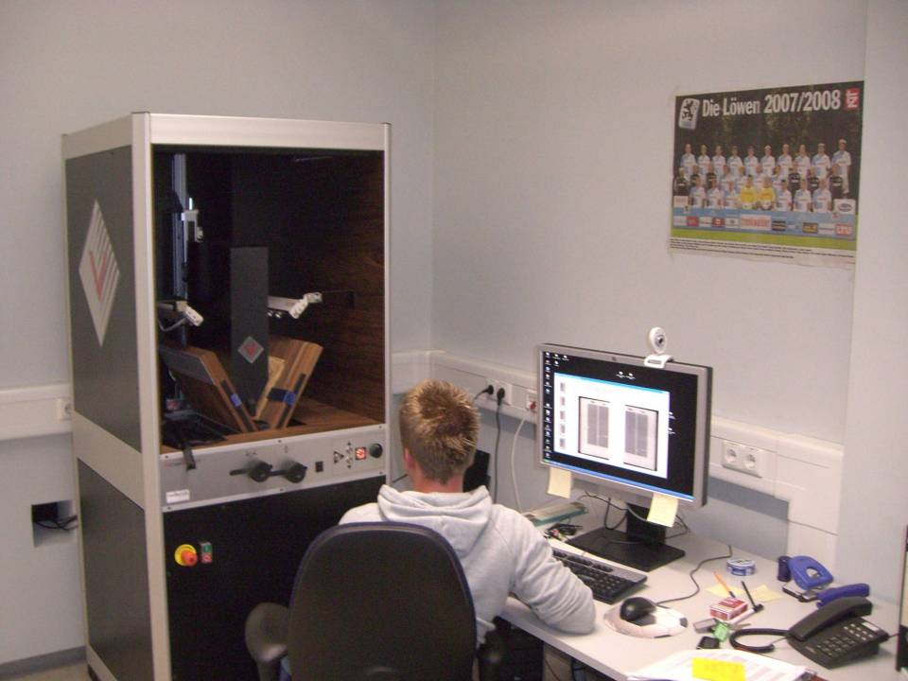
Research at LRZ
Piloting new Network Technologies
Research Topics
100 Gbit Ethernet WANs
Long-term Archiving
Projects
Rosetta (Provisioning of books)
GZEND (Digitalisation of books on a large scale)

Slide 18
Research at LRZ
Computational Science, Computer Architecture
Research Topics
Computer Architecture for Servers and Supercomputers
Energy Efficient Servers and Datacentres
Operations Strategies for Petaflop Systems
New Programming Paradigms for Petaflop Systems
Parallelization and Scaling of Applications
Visualization of Large Data Sets, Virtual Reality

Slide 19
Research at LRZ
Projects
DECI (Distributed Extreme Computing Initiative, EU)
PRACE (Partnership for Advanced Computing in Europe, EU)
KONWIHR (Free State of Bavaria)
Exa-Scale Computing (MontBlanc, DEEP/-ER; 1 Exa = 1000 Peta)

Slide 20
Research at LRZ
Grids
Research Topics
Management of Virtual Organizations (VO Mgmt)
Grid Monitoring
Security and Intrusion Detection on the Grid
Grid Middlewares
Grid-Access to the European High Performance Computing Infrastructure PRACE
World‘s biggest Grid Project EGI-Inspire
European Seismology Project VERCE

Slide 21
Cooperations and Partners
Cooperations
Munich Computational Sciences Centre (MCSC)
Munich Centre of Advanced Computing (MAC)
MAC-KAUST (King Abdullah Univ. of Science and Technology)
Gauss Centre for Supercomputing (GCS)
Partnership for Advanced Computing in Europe (PRACE)
Bayerische Staatsbibliothek - Bavarian State Library
Intel Parallel Computing Center
Cluster Universe, Large Hadron Coolider Grid
Stiftung für Hoschulstart - Trust for Admission to Higher Education

Slide 22
Cooperations and Partners
Partners
Deutsches Forschungsnetz (DFN, German NREN)
Industrial Partners (SGI, IBM, Siemens, Hewlett-Packard, Intel, Microsoft)
Munich Network Management Team

Slide 23
Munich Computational Sciences Centre
Partners
Max Planck Society (MPG)
Computing Centre Garching of MPG (RZG)
Bavarian Academy of Sciences and Humanities (BADW)
Leibniz Supercomputing Centre (LRZ)
Ludwig-Maximilians-Universität München (LMU)
Technische Universität München (TUM)
Munich Data Science Center (MDSC)

Slide 24
Munich Computational Sciences Centre
Goals:
support the development of algorithms and applications suitable for high performance computing, as well as data processing and visualization in various scientific areas,
provide a quality of scientific computing unique throughout Germany, and on an internationally competitive level.
bundle LRZ’s and RZG’s competence in the areas of high performance computing, large scale data handling and archiving, high performance networking, and optimization of HPC applications

Slide 25
The Gauss Centre for Supercomputing (GCS) A joint activity of the three German National HPC Centres
The three German national supercomputing centres at Jülich, Garching and Stuttgart joined forces in the Gauss Centre for Supercomputing
John von Neumann Institut für Computing (NIC)
Höchstleistungsrechenzentrum Stuttgart (HLRS)
Leibniz Supercomputing Centre (LRZ)
The largest and most powerful supercomputer infrastructure in Europe. Foundation of GCS (e.V.) April, 13th, 2007.
Principal Partner in EU-Project PRACE (Partnership for Advanced Computing in Europe)

Slide 26
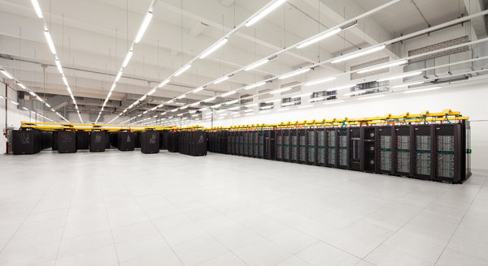
The supercomputer at LRZ: SuperMUC

Slide 27
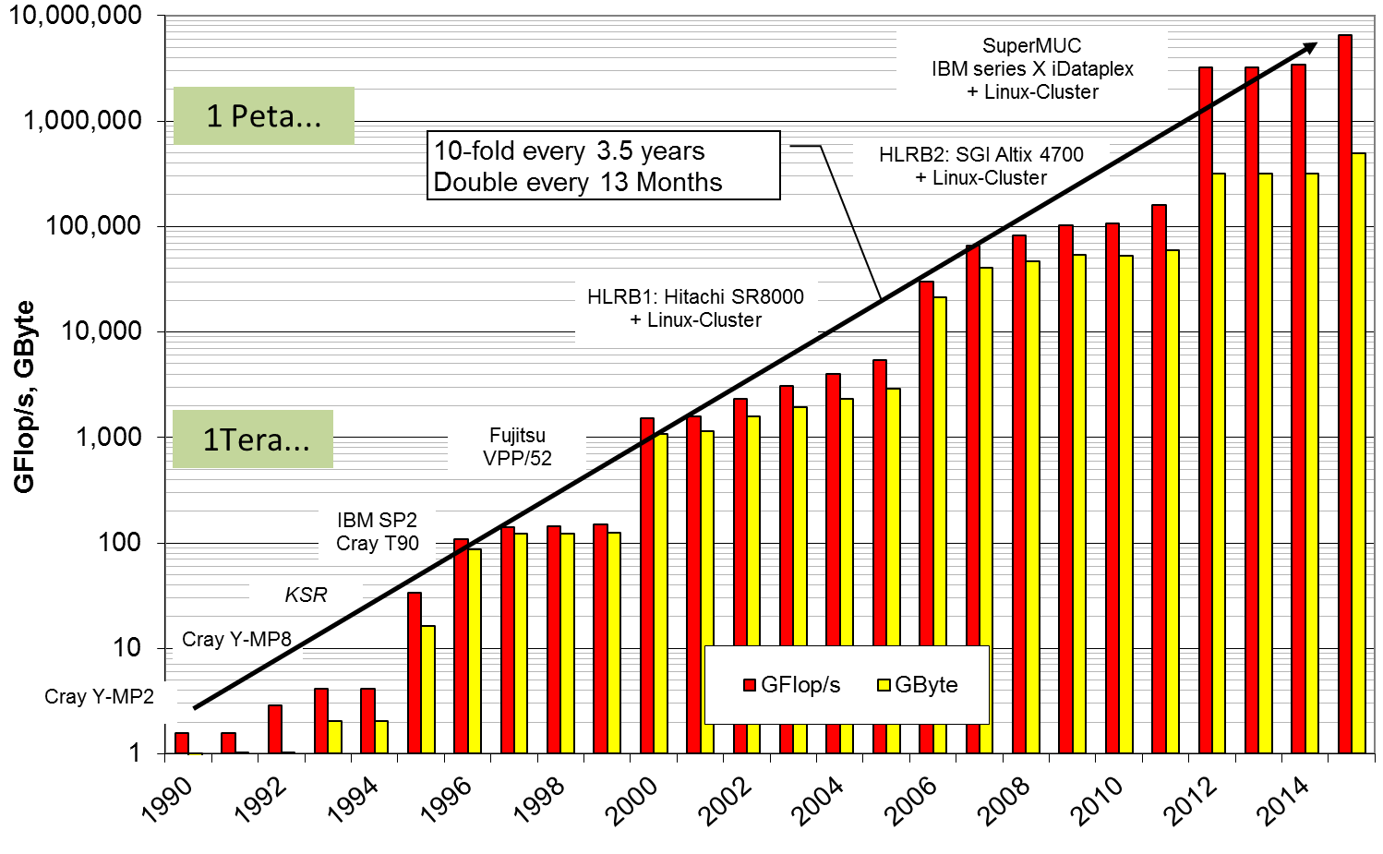
Evolution of Peak Performance and Memory (Sum over all LRZ systems)

Slide 28
Growth of Power Consumption
Estimated

Slide 29
Examples of Applications
Computational Fluid Dynamics: Optimisation of turbines and wings, noise reduction, air conditioning in trains
Fusion: Plasma in a future fusion reactor (ITER)
Astrophysics: Origin and evolution of stars and galaxies
Solid State Physics: Superconductivity, surface properties
Geophysics: Earth quake scenarios

Slide 30
Examples of Applications
Material Science: Semiconductors
Chemistry: Catalytic reactions
Medicine and Medical Engineering: Blood flow, aneurysms, air conditioning of operating theatres
Biophysics: Properties of viruses, genome analysis
Climate research: Currents in oceans

Slide 31
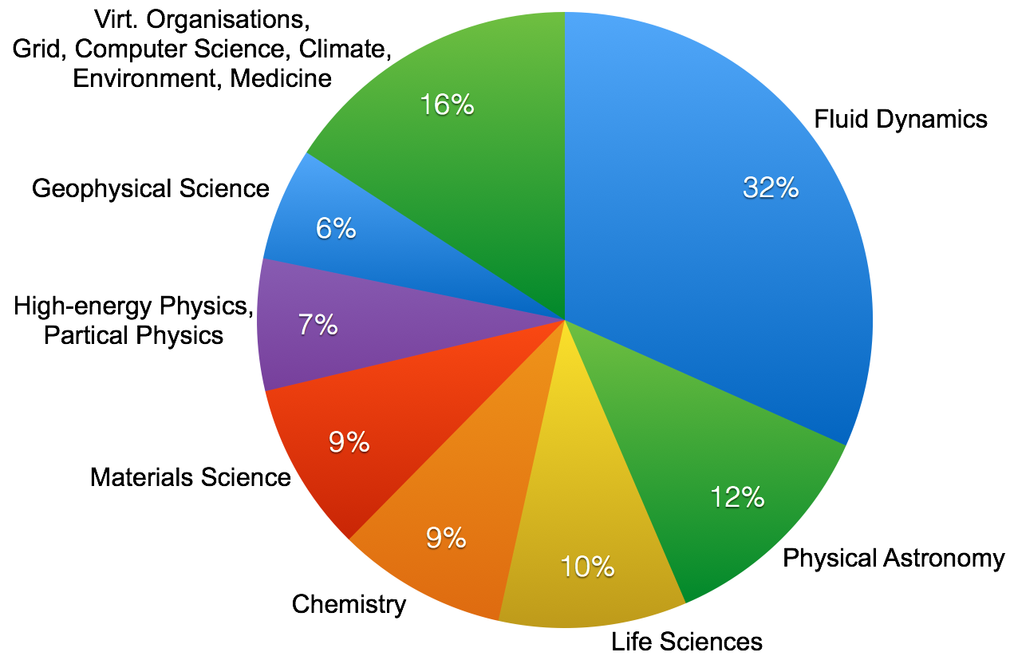
Distribution of CPU-hours by Research Area

Slide 32
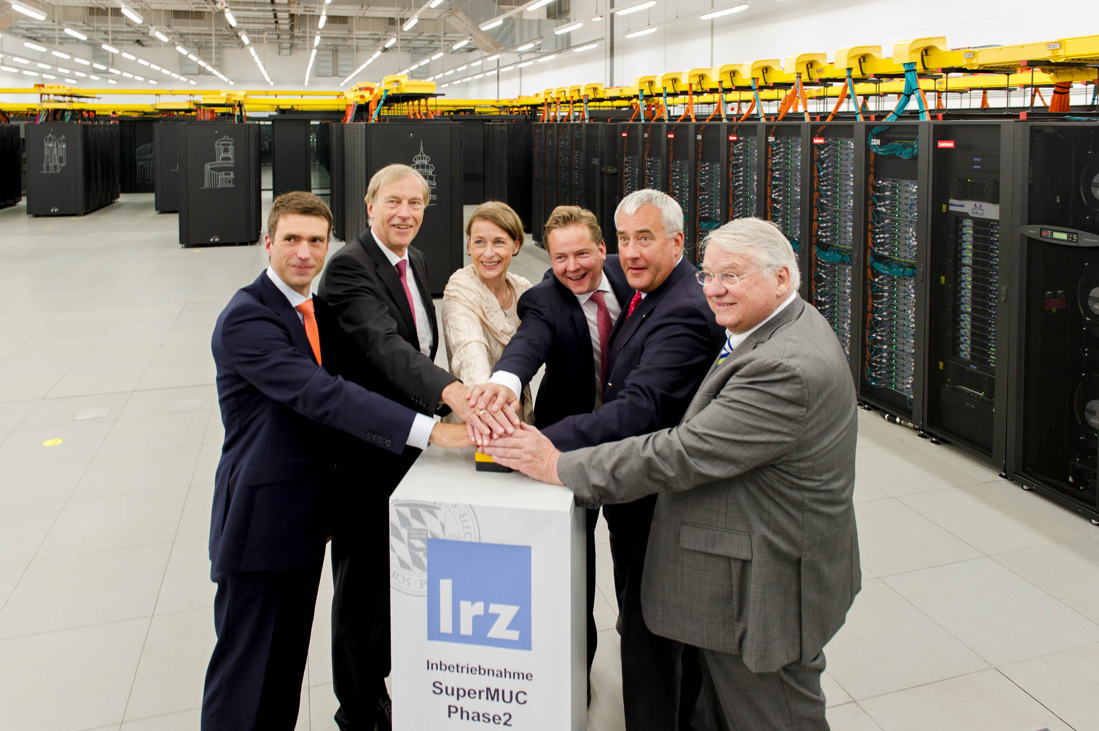
Safety instructions for Computer Cube Tour
Do not smoke
Do not take pictures
Do not use mobile phones
Do not touch
Beware of steps, man holes, cables and electricity
Beware of wet spots, vapours, obstacles (esp. ground floor)
Follow your guide, stay together

Slide 33
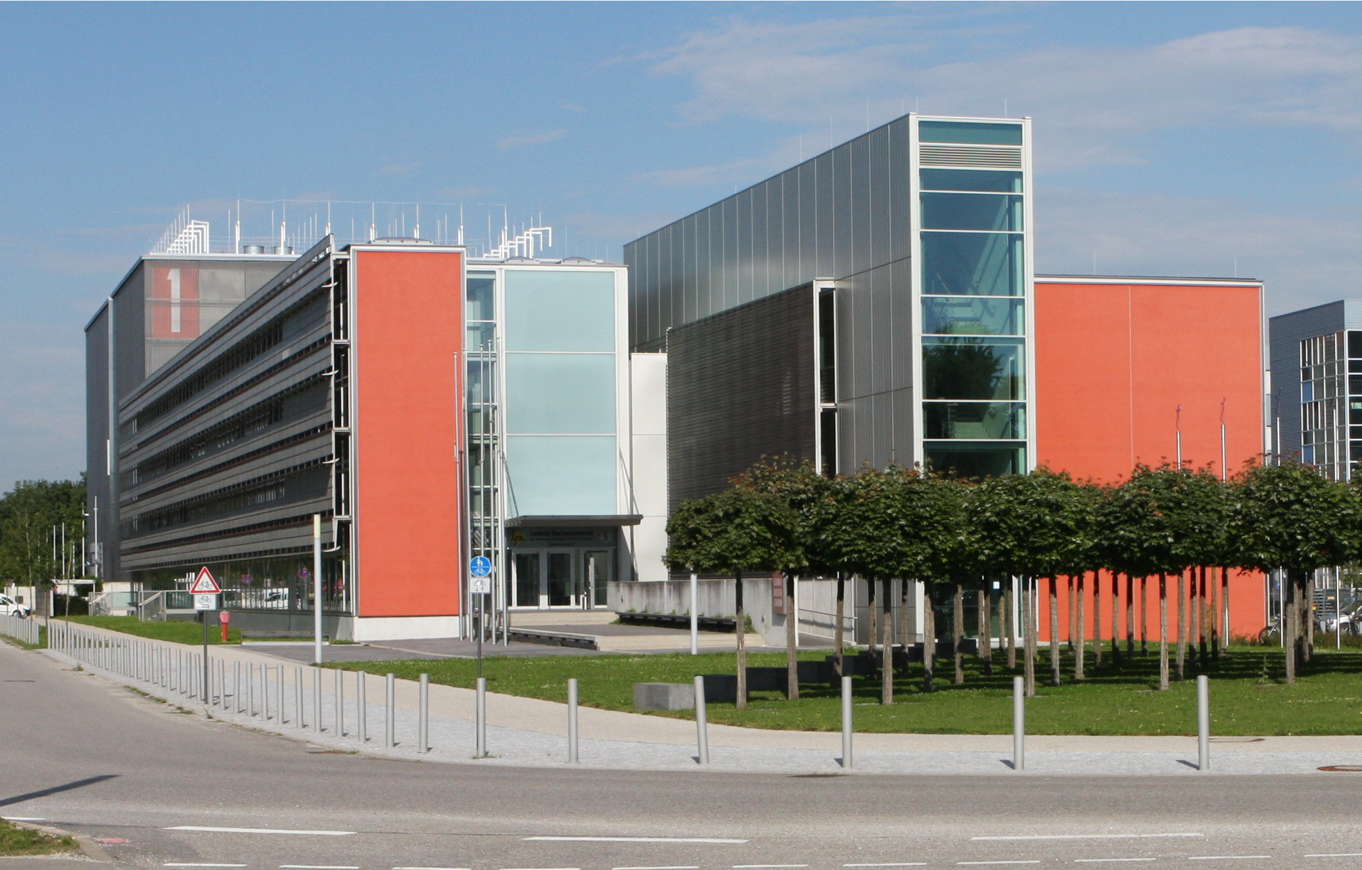
Thank you!

Slide 34
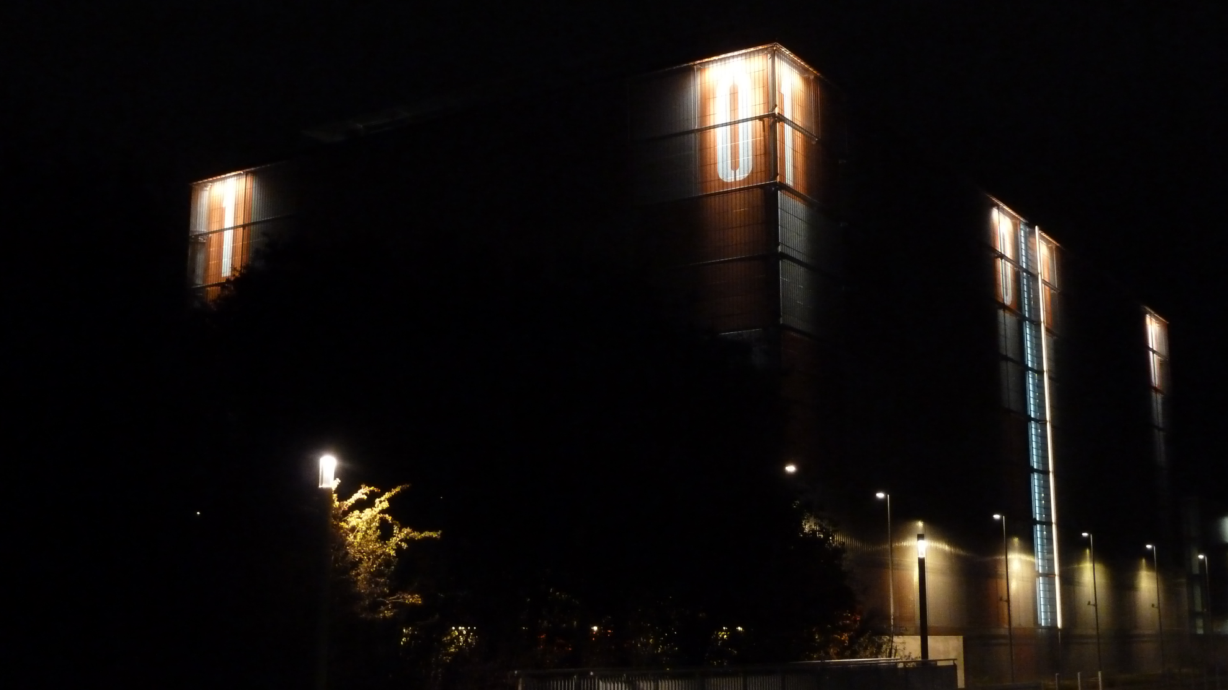
Thank you!

